Slide 2
Introduction to SQL DW
Kal Yella
Program Manager
Kayany@Microsoft.com

Slide 3
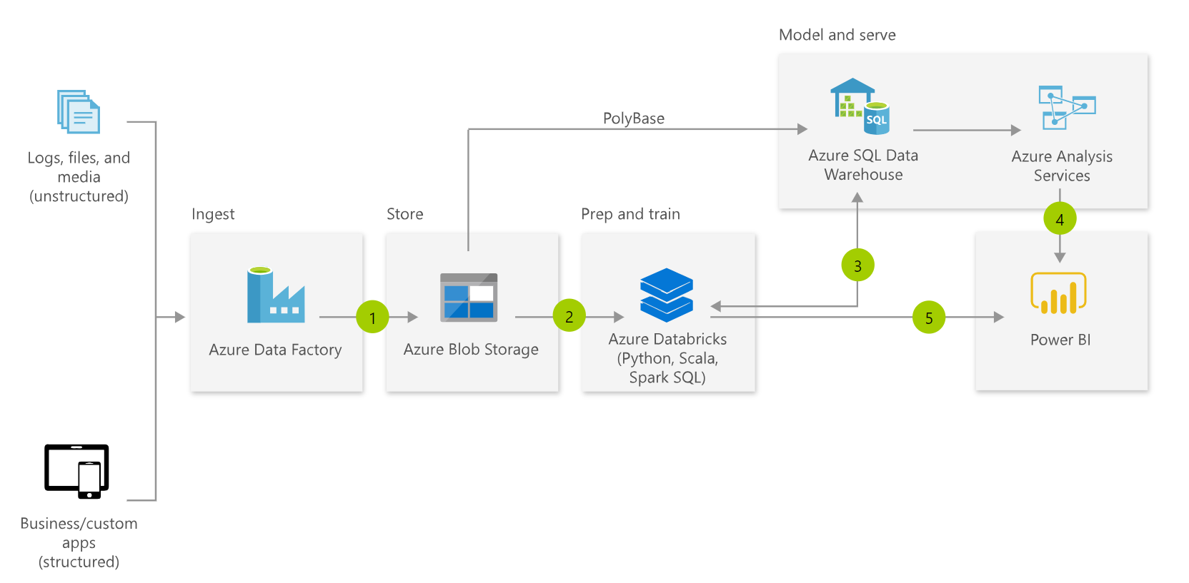
Typical MDW Architecture
Notes:
Fully managed

Slide 4
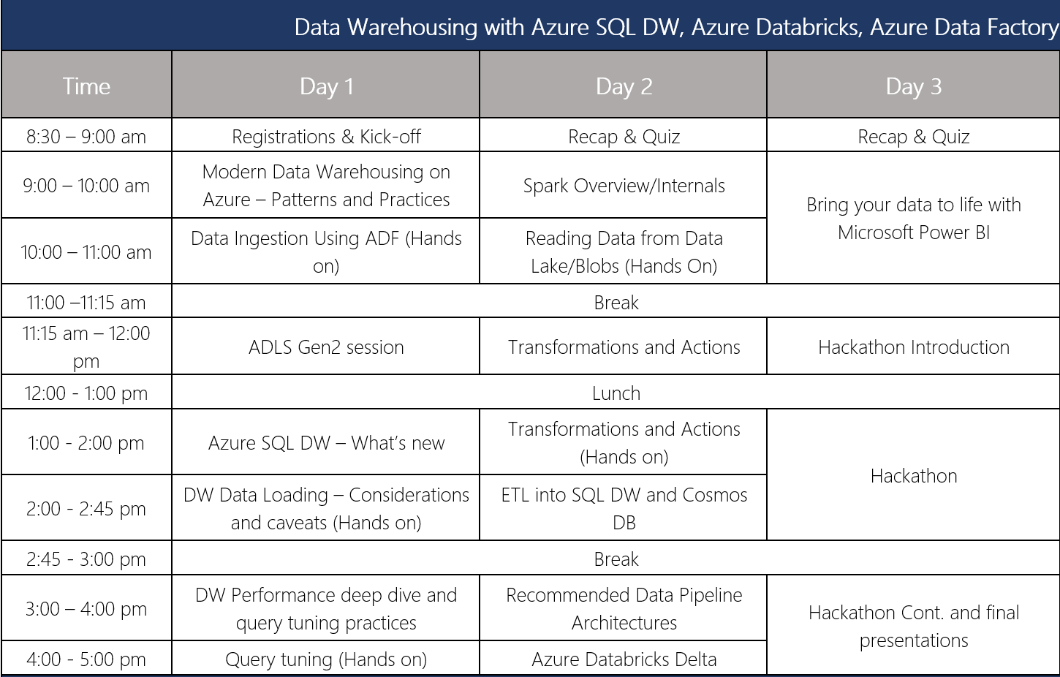
Agenda

Slide 5
http://bit.ly/2Ed6sh5
https://github.com/kyella/Airlift

Slide 6
Changes in Data Warehouse space
Integration with unstructured data
Drive to the cloud
Hardware renewal
Support costs
SQL

Slide 7



Introducing Azure SQL DW Service
A relational data warehouse-as-a-service, fully managed by Microsoft.
Industries first elastic cloud data warehouse with proven SQL Server capabilities.
Support your smallest to your largest data storage needs.
Elastic scale & performance
Market Leading Price & Performance
Powered by the Cloud
Azure
Azure
Get started in minutes
Integrated with Azure ML, PowerBI & ADF
Scales beyond petabytes of data
Cloud DW Scale-out Processing
Instant-on compute scales in seconds
Query Relational / Non-Relational
Saas
Simple billing compute & storage
Pay for what you need, when you need it with dynamic pause
Azure
Office 365
Office 365
Public
Cloud

Slide 8
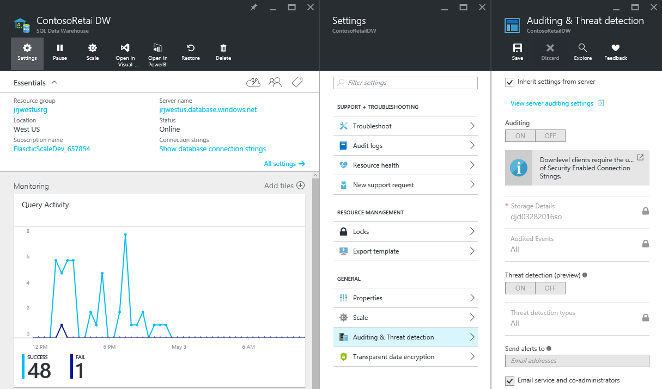
Fully managed PaaS
Notes:
Fully managed

Slide 9
Suitable workloads
Analytics
Store large volumes of data.
Consolidate disparate data into a single location.
Shape, model, transform and aggregate data.
Perform query analysis across large datasets.
Ad-hoc reporting across large data volumes.
All using simple SQL constructs.
“SQL on SQL”

Slide 10
Unsuitable workloads
Operational workloads (OLTP)
High frequency reads and writes.
Large numbers of singleton selects.
High volumes of single row inserts.
SQL
Data Preparation
Row by row processing needs.
Incompatible formats (JSON, XML).
SQL

Slide 11
Base Patterns

Slide 12






Resume / Pause Pattern
Persist
Export
Query
Stream
Import
Import
Resume
Ingest
Aggregate
Export
Pause
Lower Cost
High Concurrency
“Dashboard Query”
Notes:
Red Stars
Archive on the way in to the warehouse
Geo-redundant blob storage guarantees your data
Allows for RPO 0 Data Warehouse architectures
Allows for point in time restart-ability of ELT
Resume / Pause Pattern

Slide 13

SaaS customer isolation
DWU 200
DWU 600
Customer
Clickstream
Corporate
DWU 1200
Notes:
Red Stars
Consistent single view of raw data held in Blob Storage accessible by all consumers of data
Customer specific DWU settings allowing for simple chargeback models

Slide 14


Big Data & SQLDW
Unknown Value Data
XML
High Value Data
JSON
TEXT
Model
Load
Transform
Aggregate
Consume
Data Preparation
Pre-process
Transpose
Re-format
Batch
Ad-hoc
Batch

Slide 15
Under the hood - Architecture

Slide 16
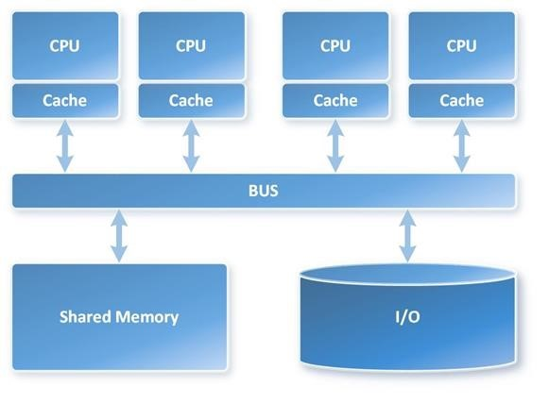
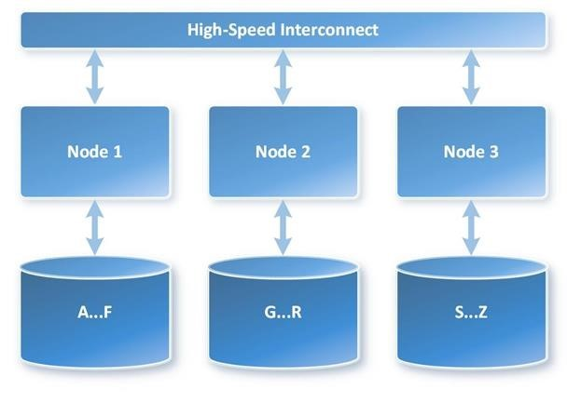
MPP vs. SMP Architecture
VS
Notes:
Symmetric Multi-Processing (SMP)
Massively Parallel Processing (MPP)
In a shared nothing architecture, there is no single point of contention across the system and nodes do not share memory or disk storage. Data is horizontally partitioned across nodes, such that each node has a subset of rows from each table in the database. Each node then processes only the rows on its own disks. Systems based on this architecture can achieve massive scale as there is no single bottleneck to slow down the system

Slide 17
SQL DW Fundamentals
Control
Control
Connection and tool endpoint. Coordinates compute activity.
Engine
DMS
SQL DB
Compute
Handles query processing, ability to scale up/down
Compute
Compute
Compute
Compute
DMS
DMS
DMS
DMS
SQL DB
SQL DB
SQL DB
SQL DB
Dist_DB_1
Dist_DB_2
Dist_DB_15
Dist_DB_16
Dist_DB_17
Dist_DB_30
Dist_DB_31
Dist_DB_32
Dist_DB_45
Dist_DB_46
Dist_DB_47
Dist_DB_60
DMS: Data Movement Services
Coordinates data movement between nodes
…
…
…
…
Azure Blob Storage
Storage
Remote storage. Scales independently of compute
Notes:
Compute Node VM hosting two key components of SQL DW.
These two key SQL DB and DMS.
DMS, stands for Data Movement Service
cover more later on why move data
SQL DB crunching the data and DMS moving
Third component to SQL DW, the Engine.
primary function is to optimize and manage incoming work.
Engine parses and creates query plans.
Compute node has several SQL databases.
MPP
60 databases equally divided
This example is DW500, each compute node is hosting 12 databases.
Let’s say we want to take this DW500 and scale it up to a DW1000
What happens behind the scenes?
(1) take all of the SQL Databases down, (2) add 5 more compute nodes
(3) start up the SQL DB databases again.
some of the databases are on different compute nodes
6 distributions per node rather than 12
Each Node has half the work now

Slide 18
Data Warehouse Units
DWU
100
200
300
400
500
600
1000
1200
1500
2000
3000
6000
…
30000
Normalized amount of compute
Converts to billing units i.e. what you pay
CPU
RAM
I/O

Slide 19

Separate compute from storage
SQL
Control
Compute
Premium Storage
Notes:
De-coupled storage from compute & control
Completely elastic
Pay for the data you store and the compute you provision

Slide 20
Independently scale compute
SQL
Control
Compute
Premium Storage
Notes:
De-coupled storage from compute & control
Completely elastic
Pay for the data you store and the compute you provision

Slide 21
Pause and resume workload
SQL
Control
Compute
Premium Storage
Notes:
De-coupled storage from compute & control
Completely elastic
Pay for the data you store and the compute you provision

Slide 22
Gen 2 Compute and Memory
Performance level | Compute nodes | Distributions per Compute node | Memory per data warehouse (GB)
DW100c | 1 | 60 | 60
DW200c | 1 | 60 | 120
DW300c | 1 | 60 | 180
DW400c | 1 | 60 | 240
DW500c | 1 | 60 | 300
DW1000c | 2 | 30 | 600
DW1500c | 3 | 20 | 900
DW2000c | 4 | 15 | 1200
DW2500c | 5 | 12 | 1500
DW3000c | 6 | 10 | 1800
DW5000c | 10 | 6 | 3000
DW6000c | 12 | 5 | 3600
DW7500c | 15 | 4 | 4500
DW10000c | 20 | 3 | 6000
DW15000c | 30 | 2 | 9000
DW30000c | 60 | 1 | 18000

Slide 23
Gen 1 Compute and Memory
Performance level | Compute nodes | Distributions per Compute node | Memory per data warehouse (GB)
DW100 | 1 | 60 | 24
DW200 | 2 | 30 | 48
DW300 | 3 | 20 | 72
DW400 | 4 | 15 | 96
DW500 | 5 | 12 | 120
DW600 | 6 | 10 | 144
DW1000 | 10 | 6 | 240
DW1200 | 12 | 5 | 288
DW1500 | 15 | 4 | 360
DW2000 | 20 | 3 | 480
DW3000 | 30 | 2 | 720
DW6000 | 60 | 1 | 1440

Slide 24


Management Interfaces
 | Portal | PowerShell | T-SQL
Create
Pause and resume
Scale

Slide 25
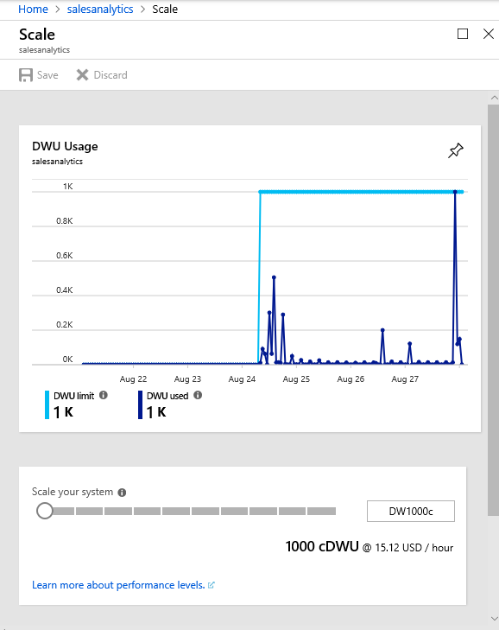
Scaling in the Portal

Slide 26
Scaling via T-SQL and PowerShell
T-SQL
ALTER DATABASE ContosoRetailDW
MODIFY (service_objective = 'DW100');
PowerShell
Set-AzureRmSqlDatabase `
–ResourceGroupName "RG_name" `
–ServerName "SRV_name" `
–DatabaseName "DB_name" `
-RequestedServiceObjectiveName "DW1000"

Slide 27
Query Execution
Result
Query
SQL
Control
Compute
Premium Storage
Notes:
De-coupled storage from compute & control
Completely elastic
Pay for the data you store and the compute you provision

Slide 28
Distributing Data
CREATE TABLE [build].[FactOnlineSales]
(
[OnlineSalesKey] int NOT NULL
, [DateKey] datetime NOT NULL
, [StoreKey] int NOT NULL
, [ProductKey] int NOT NULL
, [PromotionKey] int NOT NULL
, [CurrencyKey] int NOT NULL
, [CustomerKey] int NOT NULL
, [SalesOrderNumber] nvarchar(20) NOT NULL
, [SalesOrderLineNumber] int NULL
, [SalesQuantity] int NOT NULL
, [SalesAmount] money NOT NULL
)
WITH
(
DISTRIBUTION = HASH([ProductKey])
)
;

Slide 29
Row Store & Column Store

Slide 30
Scale out = Distributed tables
ROW STORE
COLUMN STORE

Slide 31
Data Loading

Slide 32
Data Loading
Polybase and T-SQL
ADF – (with Polybase)
SSIS – (with Polybase)
BCP
3rd Party tools

Slide 33
WHAT does PolyBase do?
Load Data
Use external tables as an ETL tool to cleanse data before loading
Age-out Data
Age data to HDFS or Azure Storage as ‘cold’ but query-able.
Interactively Query
Analyze relational and non-relational data together
HOW does it do it?
Imposes structure on semi-structured data
Define external tables over data
Reads/Writes Hadoop file formats
Text, CSV, RCFILE, ORC, Parquet, Avro, etc.
Parallelizes Data Transfers
Direct loads to service compute nodes

Slide 34
Parallel Load
Compute Node
Azure Storage Blob (ASB)
DMS
Bridge
Control Node
Compute Node
DMS
DMS
Bridge
Compute Node
DMS
Bridge
Notes:
BCP and SSIS come through the “front-door” Control Node

Slide 35
Data Protection

Slide 36
Backup Options
Automatic Restore Points
Snapshots taken automatically by the system.
Every few hours for an 8 hour RPO
Maintained for 7 days.
On by default, cannot be disabled.
User-Defined Restore Points
NEW!
Manually triggered
Good for snapshots before large data modifications
Can also be used to restore reporting offload instance.
Can maintain update 42 restore points.

Slide 37
Geo-redundancy
Notes:
Platform as a Service (PaaS)
Leverages the cloud
Database snapshots are taken on a regular basis to support a global 8 hour RPO
A geo redundant snapshot can be used to bring online the database in any region
1 backup a day made available
Standard RA-GRS rates (per GB)
Charged for full size of the backup

Slide 38
Workload Management

Slide 39
Concurrent queries
QID
QID
128
active queries*
1024
open sessions
QID
QID
QID
QID
Notes:
128 coming soon…

Slide 40
Resource classes
Dynamic
Increases resource consumption as you scale
No increase in concurrency as you scale
Static
Maintain resource consumption as you scale
Increase concurrent queries as you scale
Consume Slots
Increase memory
Isolate resources
Notes:
Key point:
-Dynamic: as you scale, queries have more slots and ram to run faster, not more of those queries.
-Static: as you scale, queries have the same amount of slots and ram, you can run more of them.

Slide 41
Gen 2 Concurrency – Static RC
Service Level | Maximum concurrent queries | Concurrency slots available | staticrc10 | staticrc20 | staticrc30 | staticrc40 | staticrc50 | staticrc60 | staticrc70 | staticrc80
DW100c | 4 | 4 | 1 | 2 | 4 | 4 | 4 | 4 | 4 | 4
DW200c | 8 | 8 | 1 | 2 | 4 | 8 | 8 | 8 | 8 | 8
DW300c | 12 | 12 | 1 | 2 | 4 | 8 | 8 | 8 | 8 | 8
DW400c | 16 | 16 | 1 | 2 | 4 | 8 | 16 | 16 | 16 | 16
DW500c | 20 | 20 | 1 | 2 | 4 | 8 | 16 | 16 | 16 | 16
DW1000c | 32 | 40 | 1 | 2 | 4 | 8 | 16 | 32 | 32 | 32
DW1500c | 32 | 60 | 1 | 2 | 4 | 8 | 16 | 32 | 32 | 32
DW2000c | 48 | 80 | 1 | 2 | 4 | 8 | 16 | 32 | 64 | 64
DW2500c | 48 | 100 | 1 | 2 | 4 | 8 | 16 | 32 | 64 | 64
DW3000c | 64 | 120 | 1 | 2 | 4 | 8 | 16 | 32 | 64 | 64
DW5000c | 64 | 200 | 1 | 2 | 4 | 8 | 16 | 32 | 64 | 128
DW6000c | 128 | 240 | 1 | 2 | 4 | 8 | 16 | 32 | 64 | 128
DW7500c | 128 | 300 | 1 | 2 | 4 | 8 | 16 | 32 | 64 | 128
DW10000c | 128 | 400 | 1 | 2 | 4 | 8 | 16 | 32 | 64 | 128
DW15000c | 128 | 600 | 1 | 2 | 4 | 8 | 16 | 32 | 64 | 128
DW30000c | 128 | 1200 | 1 | 2 | 4 | 8 | 16 | 32 | 64 | 128

Slide 42
Dynamic Resource Classes
4 resources classes
Resource Class | Percentage Memory
smallrc | 3%
mediumrc | 10%
largerc | 22%
xlargerc | 70%

Slide 43
Gen 2 Concurrency – Dynamic RC
Service Level | Maximum concurrent queries | Concurrency slots available | Slots used by smallrc | Slots used by mediumrc | Slots used by largerc | Slots used by xlargerc
DW100c | 4 | 4 | 1 | 1 | 1 | 2
DW200c | 8 | 8 | 1 | 1 | 1 | 5
DW300c | 12 | 12 | 1 | 1 | 2 | 8
DW400c | 16 | 16 | 1 | 1 | 3 | 11
DW500c | 20 | 20 | 1 | 2 | 4 | 14
DW1000c | 32 | 40 | 1 | 4 | 8 | 28
DW1500c | 32 | 60 | 1 | 6 | 13 | 42
DW2000c | 32 | 80 | 2 | 8 | 17 | 56
DW2500c | 32 | 100 | 3 | 10 | 22 | 70
DW3000c | 32 | 120 | 3 | 12 | 26 | 84
DW5000c | 32 | 200 | 6 | 20 | 44 | 140
DW6000c | 32 | 240 | 7 | 24 | 52 | 168
DW7500c | 32 | 300 | 9 | 30 | 66 | 210
DW10000c | 32 | 400 | 12 | 40 | 88 | 280
DW15000c | 32 | 600 | 18 | 60 | 132 | 420
DW30000c | 32 | 1200 | 36 | 120 | 264 | 840

Slide 44
Operations not governed by resource classes
Some queries always run in the smallrc resource class even though the user is a member of a larger resource class. These exempt queries do not count towards the concurrency limit.
The following statements are exempt from resource classes and always run in smallrc:
CREATE or DROP TABLE
ALTER TABLE ... SWITCH, SPLIT, or MERGE PARTITION
ALTER INDEX DISABLE
DROP INDEX
CREATE, UPDATE, or DROP STATISTICS
TRUNCATE TABLE
ALTER AUTHORIZATION
CREATE LOGIN
CREATE, ALTER, or DROP USER
CREATE, ALTER, or DROP PROCEDURE
CREATE or DROP VIEW
INSERT VALUES
SELECT from system views and DMVs
EXPLAIN
DBCC

Slide 45
Change a user's resource class
EXEC sp_addrolemember 'largerc', 'loaduser';
EXEC sp_droprolemember 'largerc', 'loaduser';

Slide 46
Monitoring

Slide 47
Monitoring Options
Azure Portal
Common interface
Alerts
Recommendations
Rention periods
Operations Management Suite (OMS) integration
Command-line
Rich set of DMVs
Lower level of diagnostics

Slide 48
Azure Portal
Key Metrics
CPU Percentage
IO Percentage
DWU (limit, used and percentage used)
Connections (successful, failed, blocked by firewall)
Gen2: Cache metrics (used and cache hit percentage)

Slide 49
Execution DMVs
Sessions
Data Movement Steps (DMS)
dm_pdw_exec_sessions
session_id (PK)
dm_pdw_dms_workers
request_id (PK)
step_index (PK)
Queries
dm_pdw_exec_requests
request_id (PK)
session_id
SQL Queries (On Operations)
Waits
Query Plan Steps
dm_pdw_sql_requests
request_id (PK)
step_index (PK)
dm_pdw_waits
request_id (PK)
object_name (PK)
dm_pdw_request_steps
request_id (PK)
step_index (PK)

Slide 50
Limits

Slide 51
Work load management
Category | Description | Maximum
Data Warehouse Units (DWU) | Max DWU for a single SQL Data Warehouse | Gen1: DW6000 Gen2: DW30000c
Data Warehouse Units (DWU) | Default DTU per server | 54,000 By default, each SQL server (for example, myserver.database.windows.net) has a DTU Quota of 54,000, which allows up to DW6000c. This quota is simply a safety limit. You can increase your quota by creating a support ticket and selecting Quota as the request type. To calculate your DTU needs, multiply the 7.5 by the total DWU needed, or multiply 9.0 by the total cDWU needed. For example: DW6000 x 7.5 = 45,000 DTUs DW6000c x 9.0 = 54,000 DTUs. You can view your current DTU consumption from the SQL server option in the portal. Both paused and unpaused databases count toward the DTU quota.
Database connection | Concurrent open sessions | 1024 Each of the 1024 active sessions can submit requests to a SQL Data Warehouse database at the same time. Note, there are limits on the number of queries that can execute concurrently. When the concurrency limit is exceeded, the request goes into an internal queue where it waits to be processed.
Database connection | Maximum memory for prepared statements | 20 MB
Workload management | Maximum concurrent queries | 128 SQL Data Warehouse can execute a maximum of 128 concurrent queries and queues remaining queries. The number of concurrent queries can decrease when users are assigned to higher resource classes or when SQL Data Warehouse has a lower data warehouse unit setting. Some queries, like DMV queries, are always allowed to run and do not impact the concurrent query limit. For more details on concurrent query execution, see the concurrency maximums article.
Tempdb | Maximum GB | 399 GB per DW100. Therefore at DWU1000, tempdb is sized to 3.99 TB.
Workload management

Slide 52
Database objects
Category | Description | Maximum
Database | Max size | Gen1: 240 TB compressed on disk. This space is independent of tempdb or log space, and therefore this space is dedicated to permanent tables. Clustered columnstore compression is estimated at 5X. This compression allows the database to grow to approximately 1 PB when all tables are clustered columnstore (the default table type). Gen2: 240TB for rowstore and unlimited storage for columnstore tables
Table | Max size | 60 TB compressed on disk
Table | Tables per database | 100,000
Table | Columns per table | 1024 columns
Table | Bytes per column | Dependent on column data type. Limit is 8000 for char data types, 4000 for nvarchar, or 2 GB for MAX data types.
Table | Bytes per row, defined size | 8060 bytes The number of bytes per row is calculated in the same manner as it is for SQL Server with page compression. Like SQL Server, SQL Data Warehouse supports row-overflow storage, which enables variable length columns to be pushed off-row. When variable length rows are pushed off-row, only 24-byte root is stored in the main record. For more information, see Row-Overflow Data Exceeding 8-KB.
Table | Partitions per table | 15,000 For high performance, we recommend minimizing the number of partitions you need while still supporting your business requirements. As the number of partitions grows, the overhead for Data Definition Language (DDL) and Data Manipulation Language (DML) operations grows and causes slower performance.
Table | Characters per partition boundary value. | 4000

Slide 53
Loading
Loads
Category | Description | Maximum
Polybase Loads | MB per row | 1 Polybase loads only to rows that are smaller than 1 MB, and cannot load to VARCHAR(MAX), NVARCHAR(MAX) or VARBINARY(MAX).

Slide 54
Queries
Category | Description | Maximum
Query | Queued queries on user tables. | 1000
Query | Concurrent queries on system views. | 100
Query | Queued queries on system views | 1000
Query | Maximum parameters | 2098
Batch | Maximum size | 65,536*4096

Slide 55
Queries
Category | Description | Maximum
SELECT results | Columns per row | 4096 You can never have more than 4096 columns per row in the SELECT result. There is no guarantee that you can always have 4096. If the query plan requires a temporary table, the 1024 columns per table maximum might apply.
SELECT | Nested subqueries | 32 You can never have more than 32 nested subqueries in a SELECT statement. There is no guarantee that you can always have 32. For example, a JOIN can introduce a subquery into the query plan. The number of subqueries can also be limited by available memory.
SELECT | Columns per JOIN | 1024 columns You can never have more than 1024 columns in the JOIN. There is no guarantee that you can always have 1024. If the JOIN plan requires a temporary table with more columns than the JOIN result, the 1024 limit applies to the temporary table.
SELECT | Bytes per GROUP BY columns. | 8060 The columns in the GROUP BY clause can have a maximum of 8060 bytes.
SELECT | Bytes per ORDER BY columns | 8060 bytes The columns in the ORDER BY clause can have a maximum of 8060 bytes

Slide 56
Queries
Category | Description | Maximum
Identifiers per statement | Number of referenced identifiers | 65,535 SQL Data Warehouse limits the number of identifiers that can be contained in a single expression of a query. Exceeding this number results in SQL Server error 8632. For more information, see Internal error: An expression services limit has been reached.
String literals | Number of string literals in a statement | 20,000 SQL Data Warehouse limits the number of string constants in a single expression of a query. Exceeding this number results in SQL Server error 8632.

Slide 57
Azure SQL DW Take-aways
No CAPEX
Low OPEX
Provision in just 5 minutes
Scale in seconds
Fully parallel load
Fully managed platform
Time to insight measured in minutes
SQL

Slide 58
Additional Resources
Azure site: http://aka.ms/sqldw
SQL DW suggestions: http://aka.ms/sql-dw-feedback
Stack Overflow – Tag: azure-sqldw
Twitter: @AzureSQLDW

